Slide 1
UNIT – I
Deep Learning Basics
Deep Learning is a subset of Machine Learning which is used to achieve Artificial Intelligence.

Slide 2
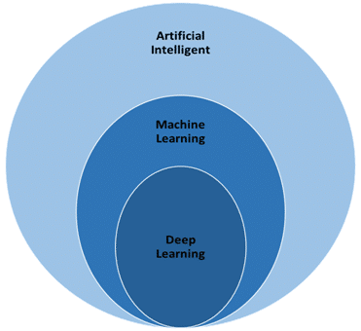
What is Deep Learning?
Artificial intelligence (AI) is the capability of a machine to imitate intelligent human behavior.
Machine learning (ML) is a branch of AI that gives computers the ability to “learn” — often from data — without being explicitly programmed.
Deep learning is a subfield of ML that uses algorithms called artificial neural networks (ANNs), which are inspired by the structure and function of the brain and are capable of self-learning.

Slide 3
Applications of Deep Learning:
Healthcare
Computer vision and pattern recognition
Computer games, robots & self-driving cars
Voice-activated intelligent assistants
Advertising
Finance etc.

Slide 4
Deep Learning v/s Machine Learning
Basis | Deep Learning | Machine Learning
Definition | Deep Learning is a type of Machine Learning itself but involving artificial neural networks and more algorithms. | A Computer program set to learn from experience E with respect to some class of tasks T and performance measure P, if its performance at tasks in T, as measure by P improves with experience E.
Subset | It is a subset of Machine Learning | Machine Learning is a subset of Artificial Intelligence.
Time involved | It involves a huge size of data points that makes it time consuming. | the size of data points in machine learning is small enough because of which the models take less time.
Learning | Learning using Neural Networks | Learning using other than NNs. Ex: KNN, SVM, Bayes etc.

Slide 5
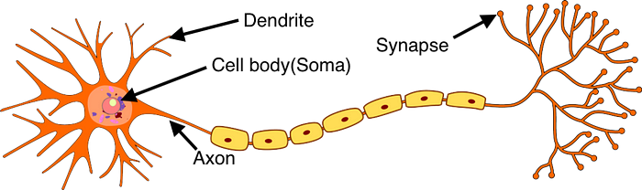
Biological Neurons
Neurons are the basic functional units of the nervous system, and they generate electrical signals called action potentials, which allows them to quickly transmit information over long distances.

Slide 6
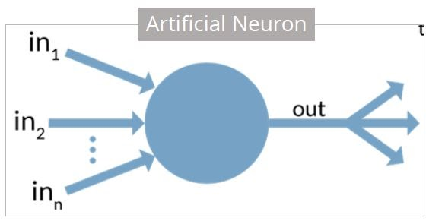
Artificial Neuron
An artificial neuron is a mathematical function based on a model of biological neurons, where each neuron takes inputs, weighs them separately, sums them up and passes this sum through a nonlinear function to produce output.
McCullock-Pitts (MCP) neuron

Slide 7
Artificial Neuron at a Glance
The artificial neuron has the following characteristics:
A neuron is a mathematical function modeled on the working of biological
neurons
It is an elementary unit in an artificial neural network
One or more inputs are separately weighted
Inputs are summed and passed through a nonlinear function to produce
output
Every neuron holds an internal state called activation signal
Each connection link carries information about the input signal
Every neuron is connected to another neuron via connection link

Slide 8
Biological Neuron | Artificial Neuron
Cell Nucleus (Soma) | Node
Dendrites | Input
Synapse | Weights or interconnections
Axon | Output

Slide 9
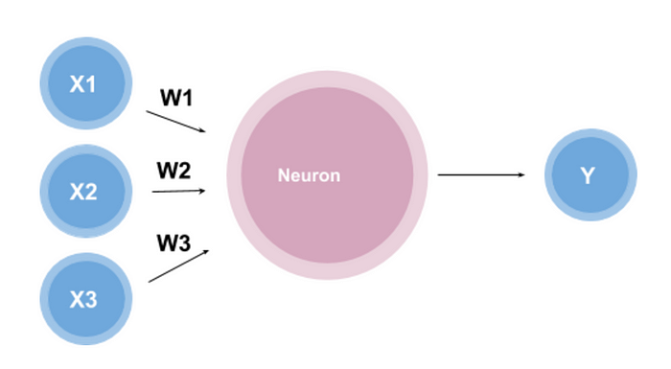
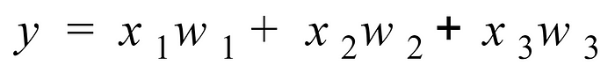
Perceptron
A perceptron works by taking in some numerical inputs along with weights and a bias.
This function is called the Weighted Sum because it is the sum of the weights and inputs.

Slide 10
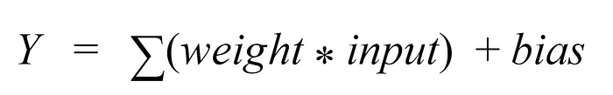
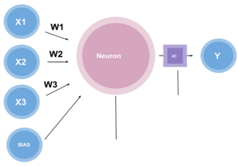
The bias is a threshold the perceptron must reach before the output is produced.
The bias term is an adjustable, numerical term added to a perceptron’s weighted sum of inputs and weights that can increase classification model accuracy.
The addition of the bias term is helpful because it serves as another model parameter (in addition to weights) that can be tuned to make the model's performance on training data as good as possible. The default input value for the bias weight is 1 and the weight value is adjustable.

Slide 11
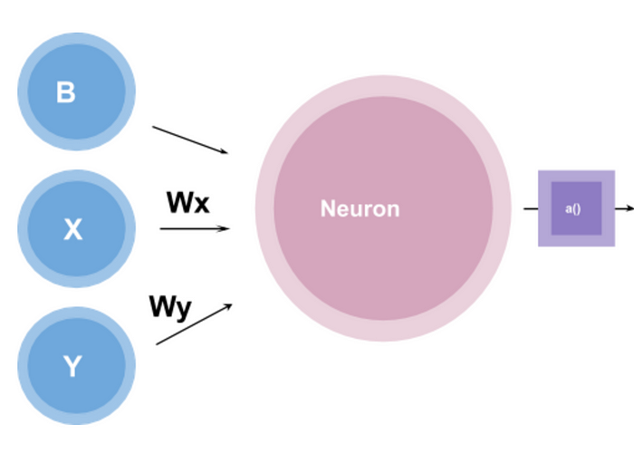
Why Perceptrons are used?
Perceptrons are the building blocks of neural networks. They are typically used for supervised learning of binary classifiers.

Slide 12
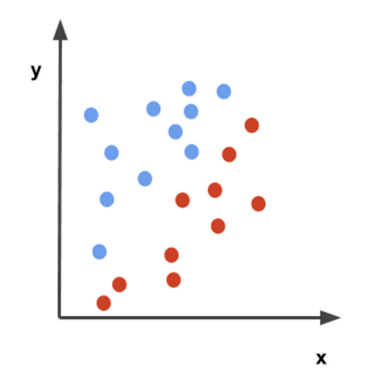
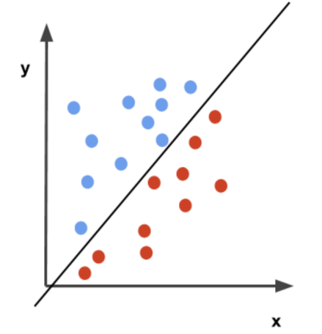
Let w_{x} = 0.5; w_{y} = 0.5 and b = 0
Then the function for the perceptron will look like,
0.5x + 0.5y = 0
Let’s suppose that the activation function, in this case, is a simple step function that outputs either 0 or 1. The perceptron function will then label the blue dots as 1 and the red dots as 0. In other words,
if 0.5x + 0.5y => 0, then 1
if 0.5x + 0.5y < 0, then 0.
Therefore, the function 0.5x + 0.5y = 0 creates a decision boundary that separates the red and blue points.
A perceptron can do basic classification using a decision boundary.

Slide 13
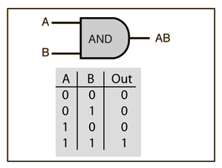
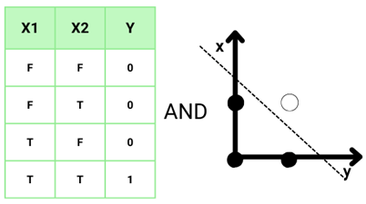
Perceptron algorithm states that:
Prediction (y`) = 1 if Wx+b > 0 and 0 if Wx+b ≤ 0

Slide 14
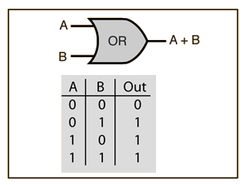
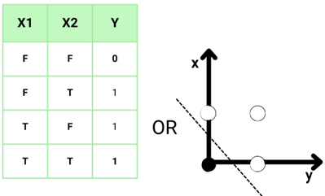

Slide 15
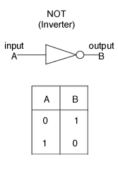

Slide 16
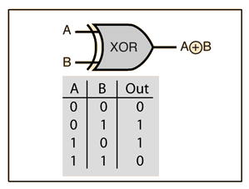
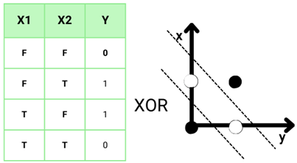
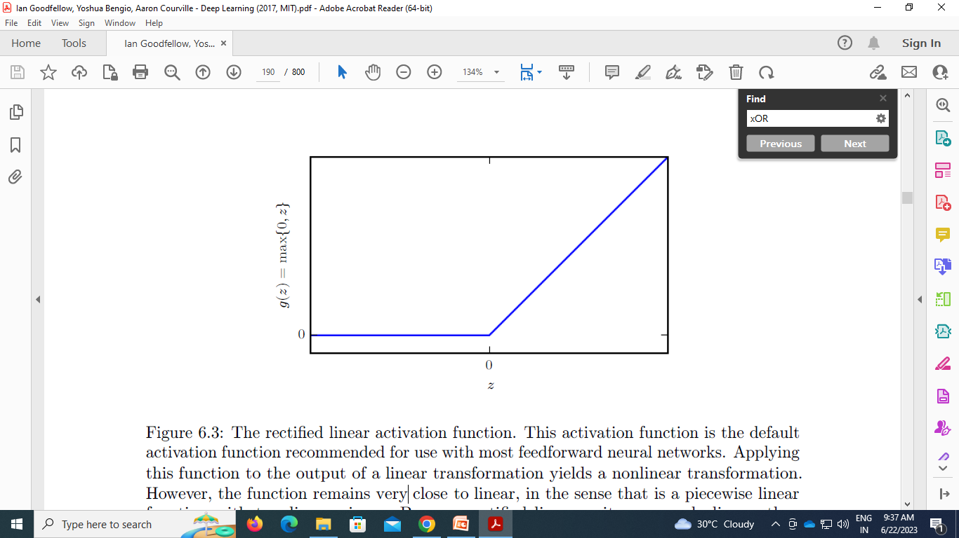

Slide 17
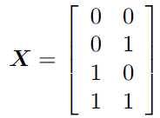
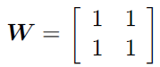
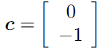
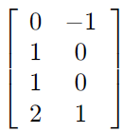
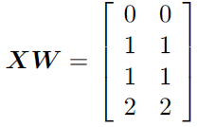

Slide 18
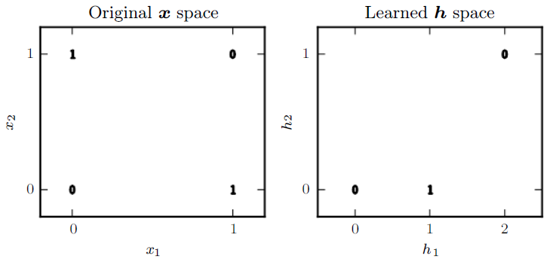

Slide 19
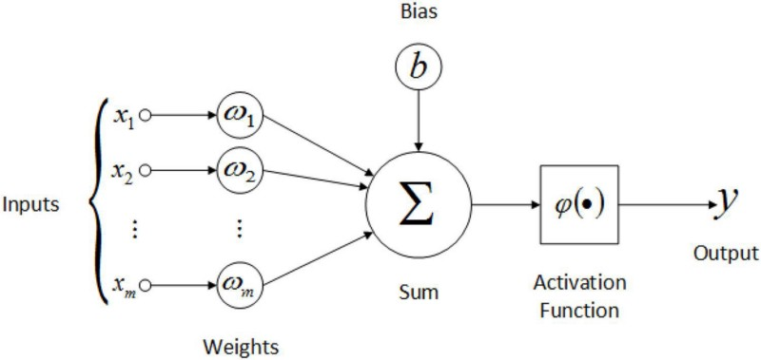
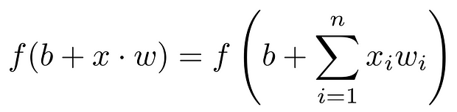
Feed-Forward Neural Network
In its most basic form, a Feed-Forward Neural Network is a single layer perceptron. A sequence of inputs enter the layer and are multiplied by the weights in this model. The weighted input values are then summed together to form a total.

Slide 20
If the sum of the values is more than a predetermined threshold, which is normally set at zero, the output value is usually 1, and if the sum is less than the threshold, the output value is usually -1.
The single-layer perceptron is a popular feed-forward neural network model that is frequently used for classification.
Single-layer perceptrons can also contain machine learning features.
The neural network can compare the outputs of its nodes with the desired values using a property known as the delta rule, allowing the network to alter its weights through training to create more accurate output values.
This training and learning procedure results in gradient descent. The technique of updating weights in multi-layered perceptrons is virtually the same, however, the process is referred to as back-propagation. In such circumstances, the output values provided by the final layer are used to alter each hidden layer inside the network.

Slide 21
Activation Function
The activation function decides whether a neuron should be activated or not by calculating the weighted sum and further adding bias to it. The purpose of the activation function is to introduce non-linearity into the output of a neuron.
The activation function does the non-linear transformation to the input making it capable to learn and perform more complex tasks.

Slide 22
Variants of Activation Function
1.Linear Function
Equation : Linear function has the equation similar to as of a straight line i.e. y = x
No matter how many layers we have, if all are linear in nature, the final activation function of last layer is nothing but just a linear function of the input of first layer.
Range : -∞ to + ∞
Uses : Linear activation function is used at just one place i.e. output layer.
Issues : If we will differentiate linear function to bring non-linearity, result will no more depend on input “x” and function will become constant, it won’t introduce any ground-breaking behavior to our algorithm.

Slide 23
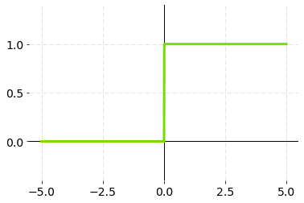
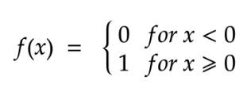
2. Binary Step Activation Function
The activation function compares the input value to a threshold value. If the input value is greater than the threshold value, the neuron is activated. It’s disabled if the input value is less than the threshold value, which means its output isn’t sent on to the next or hidden layer.
It cannot provide multi-value outputs — for example, it cannot be used for multi-class classification problems.
The step function’s gradient is zero, which makes the back propagation procedure difficult.

Slide 24
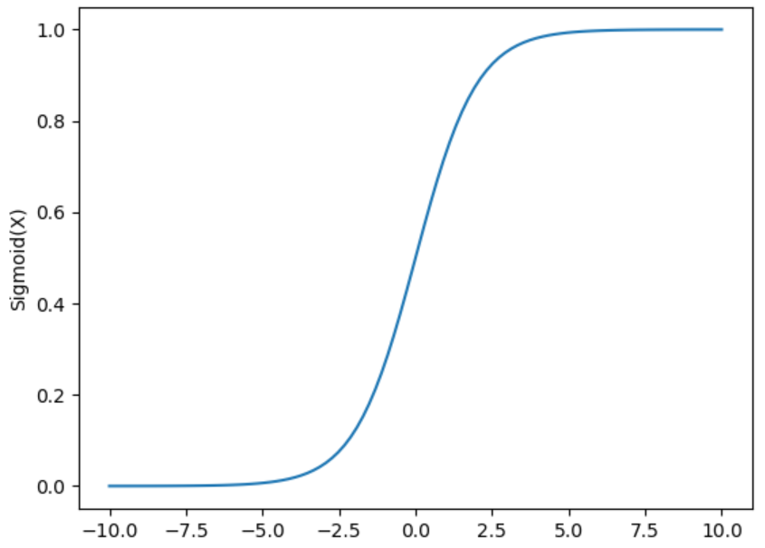
3. Sigmoid Function
Equation : f(x) = 1/(1 + e^{-x})
Nature : Non-linear. Notice that X values lies between -2 to 2, Y values are very steep. This means, small changes in x would also bring about large changes in the value of Y.
Value Range : 0 to 1
Uses : Usually used in output layer of a binary classification, where result is either 0 or 1, as value for sigmoid function lies between 0 and 1 only so, result can be predicted easily to be 1 if value is greater than 0.5 and 0 otherwise.

Slide 25
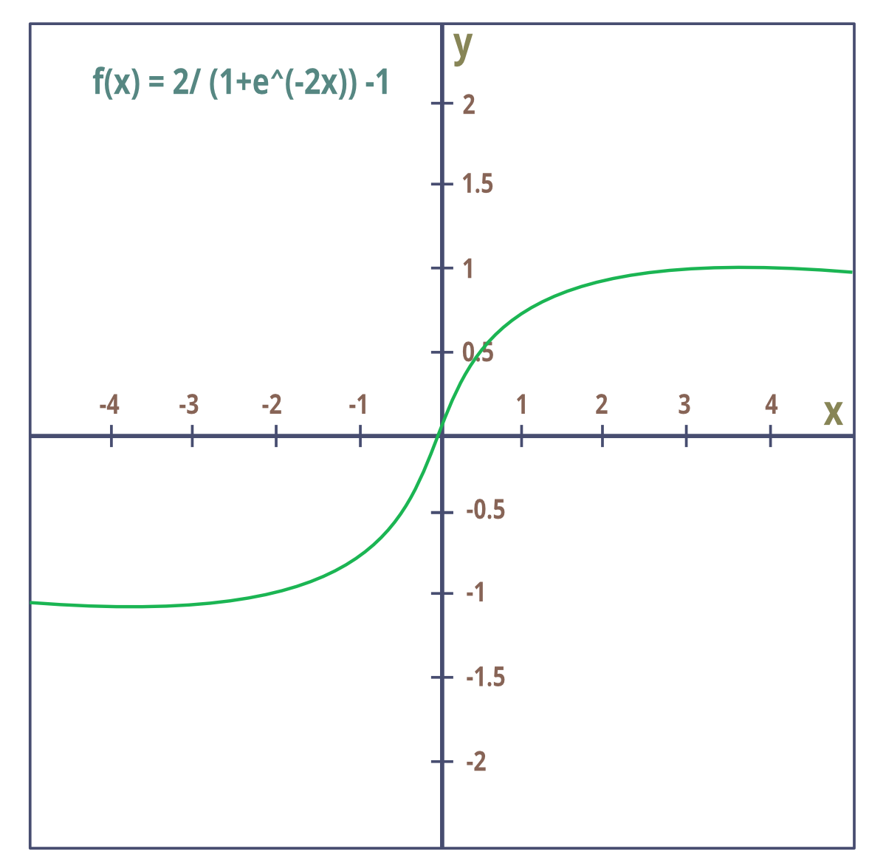
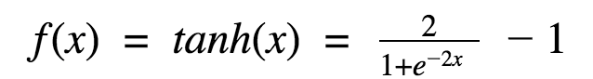
4.Tanh Function
The activation that works almost always better than sigmoid function is “Tanh” function also known as Tangent Hyperbolic function. It’s actually mathematically shifted version of the sigmoid function. Both are similar and can be derived from each other.
Equation :-
Value Range :- -1 to +1
Nature :- non-linear
Uses :- Usually used in hidden layers of a neural network as it’s values lies between -1 to 1 hence the mean for the hidden layer comes out be 0 or very close to it, hence helps in centering the data by bringing mean close to 0. This makes learning for the next layer much easier.

Slide 26
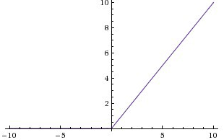
5. RELU Function
It Stands for Rectified linear unit. It is the most widely used activation function. Chiefly implemented in hidden layers of Neural network.
Equation :- f(x) = max(0,x). It gives an output x if x is positive and 0 otherwise.
Value Range :- [0, inf)
Nature :- non-linear, which means we can easily backpropagate the errors and have multiple layers of neurons being activated by the ReLU function.
Uses :- ReLu is less computationally expensive than tanh and sigmoid because it involves simpler mathematical operations. At a time only a few neurons are activated making the network sparse making it efficient and easy for computation. In simple words, RELU learns much faster than sigmoid and Tanh function.

Slide 27
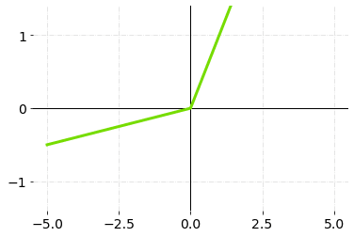
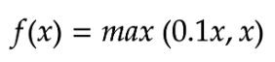
6. Leaky ReLU
Leaky ReLU is an upgraded version of the ReLU activation function to solve the dying ReLU problem, as it has a small positive slope in the negative area.
Pros and Cons:
The advantages of Leaky ReLU are the same as that of ReLU, in addition to the fact that it does enable back propagation, even for negative input values.
Making minor modification of negative input values, the gradient of the left side of the graph comes out to be a real (non-zero) value. As a result, there would be no more dead neurons in that area.
The predictions may not be steady for negative input values.

Slide 28
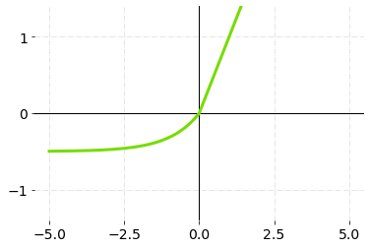
7. ELU (Exponential Linear Units)
ELU is also one of the variations of ReLU which also solves the dead ReLU problem. ELU, just like leaky ReLU also considers negative values by introducing a new alpha parameter and multiplying it will another equation.
ELU is slightly more computationally expensive than leaky ReLU.
Pros and Cons
ELU is a strong alternative to ReLU. Different from the ReLU, ELU can produce negative outputs.
Exponential operations are there in ELU, So it increases the computational time.
No learning about the ‘α’ value takes place, and exploding gradient problem.

Slide 29
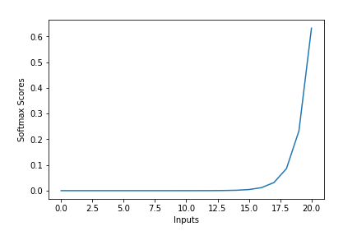
8. Softmax Function
The softmax function is also a type of sigmoid function but is handy when we are trying to handle multi- class classification problems.
Nature :- non-linear
Uses :- Usually used when trying to handle multiple classes. The softmax function was commonly found in the output layer of image classification problems. The softmax function would squeeze the outputs for each class between 0 and 1 and would also divide by the sum of the outputs.
Output:- The softmax function is ideally used in the output layer of the classifier where we are actually trying to attain the probabilities to define the class of each input.

Slide 30
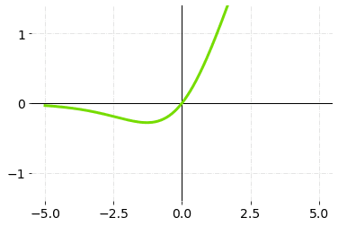
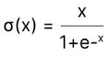
9. Swish
Swish allows for the propagation of a few numbers of negative weights, whereas ReLU sets all non-positive weights to zero. This is a crucial property that determines the success of non-monotonic smooth activation functions, such as Swish’s, in progressively deep neural networks.
It’s a self-gated activation function created by Google researchers.
Pros and Cons
Swish is a smooth activation function that means that it does not suddenly change direction like ReLU does near x equal to zero. Rather, it smoothly bends from 0 towards values < 0 and then upwards again.
Non-positive values were zeroed out in ReLU activation function. Negative numbers, on the other hand, may be valuable for detecting patterns in the data. Because of the sparsity, large negative numbers are wiped out, resulting in a win-win situation.
The swish activation function being non-monotonous enhances the term of input data and weight to be learnt.
Slightly more computationally expensive and More problems with the algorithm will probably arise given time.

Slide 31
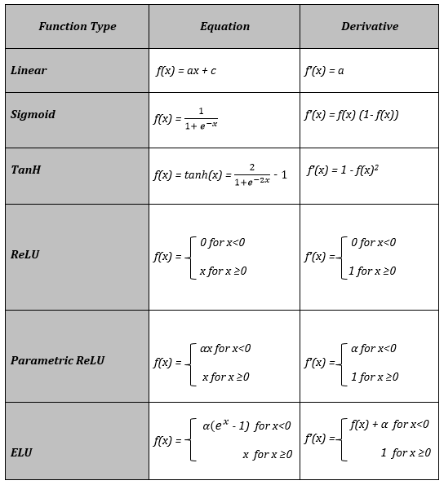
Activation Functions and
their Derivatives

Slide 32
Important Considerations
Vanishing gradient is a common problem encountered during neural network training. Like a sigmoid activation function, some activation functions have a small output range (0 to 1). So a huge change in the input of the sigmoid activation function will create a small modification in the output. Therefore, the derivative also becomes small. These activation functions are only used for shallow networks with only a few layers. When these activation functions are applied to a multi-layer network, the gradient may become too small for expected training.
Exploding gradients are situations in which massive incorrect gradients build during training, resulting in huge updates to neural network model weights. When there are exploding gradients, an unstable network might form, and training cannot be completed. Due to exploding gradients, the weights’ values can potentially grow to the point where they overflow, resulting in loss in NaN values.

Slide 33
All hidden layers generally use the same activation functions. ReLU activation function should only be used in the hidden layer for better results.
Sigmoid and TanH activation functions should not be utilized in hidden layers due to the vanishing gradient, since they make the model more susceptible to problems during training.
Swish function is used in artificial neural networks having a depth more than 40 layers.
Regression problems should use linear activation functions
If your output is for binary classification then, sigmoid function is very natural choice for output layer.
If your output is for multi-class classification then, Softmax is very useful to predict the probabilities of each classes.
Neural network architecture and their usable activation functions,
Convolutional Neural Network (CNN): ReLU activation function
Recurrent Neural Network (RNN): TanH or sigmoid activation functions

Slide 34
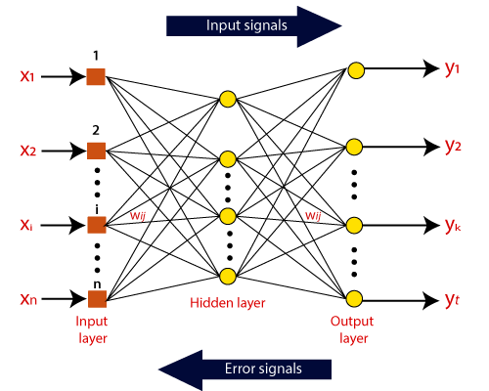
Loss and Cost Functions in Deep Learning

Slide 35
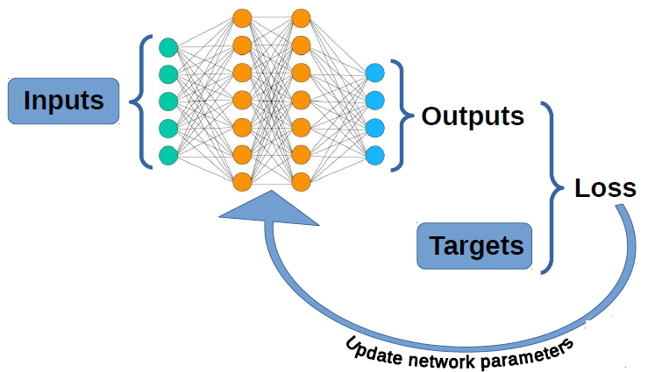
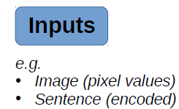
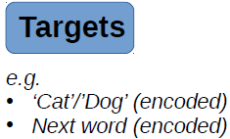
Loss and Cost Functions in Deep Learning
How good is your neural network?

Slide 36
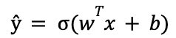
This equation represents how a neural network processes the input data at each layer and eventually produces a predicted output value
To train — the process by which the model maps the relationship between the training data and the outputs — the neural network updates its hyper parameters, the weights, w^{T}, and biases, b, to satisfy the equation above

Slide 37
What is Loss Function in Deep Learning?
In mathematical optimization and decision theory, a Loss or Cost Function (sometimes also referred to as an Error Function) is a tool for intuitively measuring the cost associated with an event or varying values of certain variables. In simpler terms, it is a way of evaluating how accurately an algorithm is fitting data from your dataset. It is essentially a mathematical function of the parameters used in any given machine learning algorithm.
A loss function is a function that compares the target and predicted output values; measures how well the neural network models the training data. When training, we aim to minimize this loss between the predicted and target outputs.
The hyper-parameters are adjusted to minimize the average loss — we find the weights, w^{T}, and biases, b, that minimize the value of J (average loss).
The loss function is very important in determining how well your algorithm fits your dataset. If the value of the loss function is low, then it's a good model; otherwise, we have to alter the parameters of the model and reduce the loss.
Loss function represents error corresponding to one training sample. Cost function represents error over the entire dataset.

Slide 38
Loss and Cost Functions in Deep Learning
Regression
MSE(Mean Squared Error)
MAE(Mean Absolute Error)
Hubber loss
Classification
Binary cross-entropy
Categorical cross-entropy
AutoEncoder
KL Divergence
GAN
Discriminator loss
Minmax GAN loss
Object detection
Focal loss

Slide 39
Each training input is loaded into the neural network in a process called forward propagation. Once the model has produced an output, this predicted output is compared against the given target output in a process called back-propagation — the hyper parameters of the model are then adjusted so that it now outputs a result closer to the target output.

Slide 40
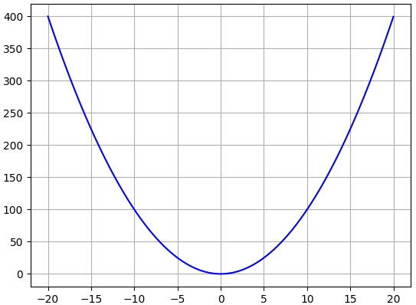
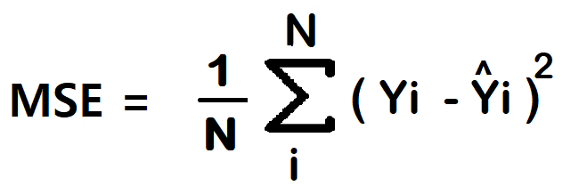
(1) Mean Squared Error (MSE)/ Squared loss/ L2 loss)
To calculate the MSE, you take the difference between the model’s predictions and the ground truth, square it, and average it out across the whole dataset.
The MSE will never be negative, since we are always squaring the errors.
Where N is the number of samples
we are testing against.
Advantage of L2 loss
Easy to interpret.
Always differential because of the square.
Only one local minima.
Disadvantage of L2 loss
Error unit in the square. because the unit in the square is not understood properly.
Not robust to outlier

Slide 41
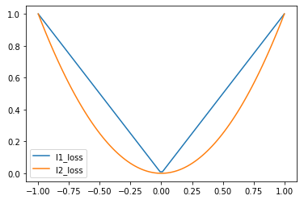
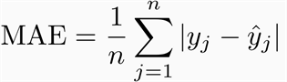
Mean Absolute Error (MAE)
To calculate the MAE, take the difference between model’s predictions and the ground truth, apply the absolute value to that difference, and then average it out across the whole dataset.
The MAE, like the MSE, will never be negative since in this case we are always taking the absolute value of the errors.
Advantage
1. Intuitive and easy
2. Error Unit Same as the output column.
3. Robust to outlier
Disadvantage
Graph, not differential. we can not use gradient
descent directly, then we can subgradient calculation.

Slide 42
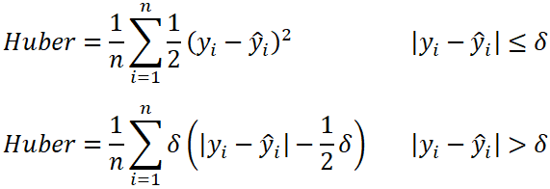
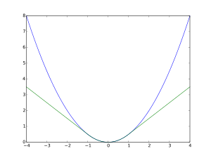
Huber Loss
In statistics, the Huber loss is a loss function used in robust regression, that is less sensitive to outliers in data than the squared error loss.
n – the number of data points.
y – the actual value of the data point. Also known as true value.
ŷ – the predicted value of the data point. This value is returned by the model.
δ – defines the point where the Huber loss function transitions from a quadratic to linear

Slide 43
Huber loss combines the best features of MSE and AE:
- like MSE for small errors.
- like AE otherwise.
- This avoids over-shooting:
- MSE has a very steep gradient when the error is large (i.e. for outliers) because of its quadratic form.
- AE has a steep gradient when the error is small because it doesn’t have a ‘flat’ bottom.
Advantage
Robust to outlier
It lies between MAE and MSE.
Disadvantage
Its main disadvantage is the associated complexity. In order to maximize model accuracy, the hyper-parameter δ will also need to be optimized which increases the training requirements

Slide 44
Classification loss functions
Cross Entropy Loss
Used when the target output representation is probability Distribution
e.g., a single output unit that indicates the classification decision (yes, no) for an input
output y ∈[0, 1] denotes Bernoulli likelihood of class membership
Target indicates true class probability.
Cross Entropy Measures distance in bits from predicted distribution to target distribution.
Binary cross-entropy Loss or Log Loss
Categorical cross-entropy

Slide 45

Binary cross-entropy Loss/ Log loss

Slide 46

Binary cross-entropy Loss/ Log Loss

Slide 47
Binary cross-entropy Loss/ Log loss
Advantage –
A cost function is a differential.
Disadvantage –
Multiple local minima
Not intuitive

Slide 48

Categorical cross-entropy
This loss function can also be used when you have a single binary
(e.g. yes/no) output

Slide 49


Back-Propagation

Slide 50

Layer-1

Slide 51


Matrix Operation:
Relu operation:

Slide 52

Example:

Slide 53

Layer-2

Slide 54


Matrix Operation:
Sigmoid operation:

Slide 55

Example:

Slide 56

Layer-3

Slide 57


Matrix Operation:
Sigmoid operation:

Slide 58

Example:

Slide 59

The Target Output should be [1.0, 0.0, 0.0]
but we got [0.2698, 0.3223, 0.4078].
Calculate error, lets use Binary cross-entropy loss

Slide 60



Derivatives of Activation Functions:

Slide 61


BackPropagating the error —
(Hidden Layer2 — Output Layer) Weights

Slide 62



Slide 63




Slide 64


For each input to neuron let us calculate the derivative with respect to each weight.
By symmetry we can calculate other derivatives also

Slide 65




Finally Let us calculate the change in
Which will be simply
Using Chain Rule:

Slide 66


Slide 67

Considering a learning rate of 0.01 we get our final weight matrix as

Slide 68



BackPropagating the error —
(Hidden Layer1 — Hidden Layer 2) Weights

Slide 69

For each input to neuron let us calculate the derivative with respect to each weight. Now let us look at the final derivative

Slide 70


Slide 71



Now we will calculate the derivative of
which will be simply
Using Chain Rule:

Slide 72

By symmetry we get the final matrix as,

Slide 73



Slide 74


by symmetry we get the final matrix as,

Slide 75



Slide 76


Slide 77


Slide 78

Consider a learning rate (lr) of 0.01 We get our final Weight matrix as

Slide 79

BackPropagating the error —
(Input Layer — Hidden Layer 1) Weights.

Slide 80




Slide 81


Slide 82



Now we will calculate the change in
and generalize it to all variables. This will be simply
Using chain rule,

Slide 83

By symmetry,

Slide 84


Slide 85


Slide 86



Slide 87


Slide 88


Initial Weights:
Final Weights:

